Slide 1
IOT Based Smart Restaurant Menu Using BB-WI
Task
PCB Designing of Receiver Side
Submitted to:
Prof. Mike Aleshams
Submitted by:
Ramandeep Kaur
Group 3

Slide 2
PCB
A printed circuit board mechanically supports and electrically connects electrical or electronic components using conductive tracks,pads and other features etched from one or more sheet layers of copper laminated onto and or between sheet layers of a non-conductive substrate. Components are generally soldered onto the PCB to both electrically connect and mechanically fasten them to it.

Slide 3
Softwares for PCB Designing
EasyEda
PROTEL(Altium designer)
PADS
ORCAD
Fritzing
Kicad
Allegro
And some more………

Slide 4
EasyEDA
EasyEDA is an easier and powerful online PCB design tool that allows electronics engineers, educators, students, makers, and enthusiasts to design and share their projects.Some features of EasyEDA,Bill of Materials, Gerber files and pick and place files and documentary outputs in PDF, PNG and SVG formats,

Slide 5
Components
Beaglebone Black Wireless
Buzzer
XBee module
MQ 9 Sensor
MQ 2 Sensor
Temperaturen Sensor
Opto-coupler
Fan
Node MCU
LCD display

Slide 6
Communication Protocol
UART (Universal asynchronous receiver-transmitter)
XBee Module
Node MCU
GPIO (General purpose input/output)
Buzzer
LPG Gas & Smoke Sensor
CO Sensor
Temperature Sensor
Opto-coupler
LCD Display

Slide 7
Beaglebone Black Wireless
Based on the extremely successful open-source Beaglebone Black hardware design, Beaglebone Black Wireless is a high-expansion, maker-focused, community-supported open hardware computer created by the BeagleBoard.org Foundation.

Slide 8
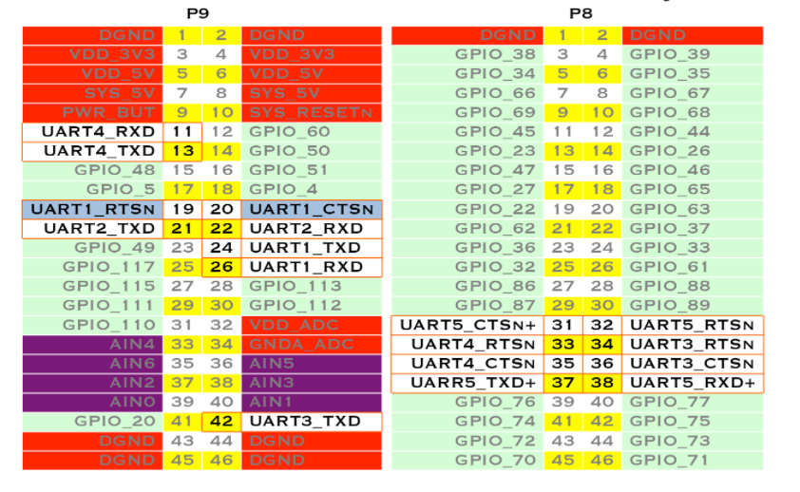
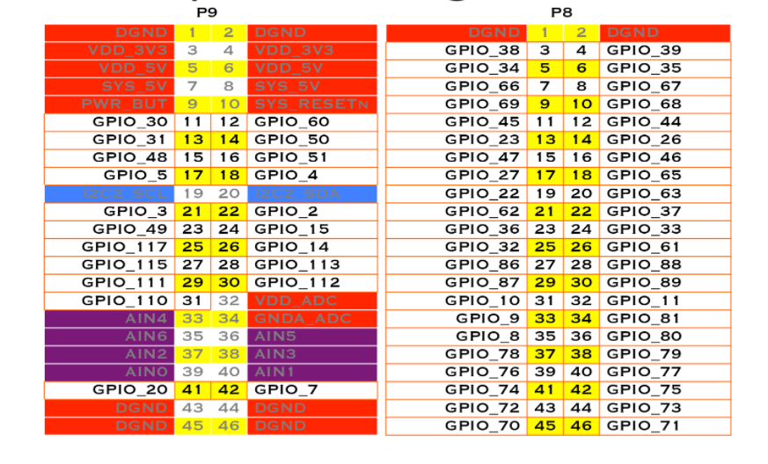
Pin Description of BB-WI

Slide 9
Xbee Module
XBee S2C is a RF module designed for wireless communication or data exchange and it works on ZigBee mesh communication protocols.The module provides wireless connectivity to end-point devices in any ZigBee mesh networks including devices from other vendors.

Slide 10
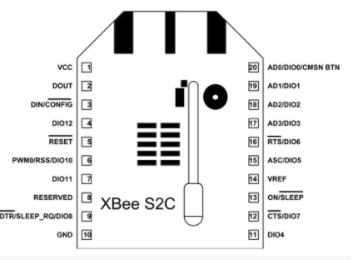
Pin Diagram of Xbee Module

Slide 11
Pin Description of Xbee Module
Pin | Name | Description
1 | VCC | Power supply
2 | DOUT/DIO13 | UART data out pin (TXD)/GPIO
3 | DIN/CONFIG / DIO14 | UART data in pin (RXD)/ GPIO
4 | DIO12/SPI_MISO | GPIO/ Master Input-Slave Output pin of SPI interface
5 | RESET | Module Reset pin

Slide 12
Pin Description of Xbee Module
Pin | Name | Description
6 | RSS PWM /DIO10 | RX Signal Strength Indicator pin / GPIO
7 | PWM1/DIO11 | Pulse Width Modulator/GPIO
8 | RESERVED | Do not connect
9 | DTR/SLEEP_RQ/ DIO8 | Pin Sleep Control line /GPIO
10 | GND | Ground

Slide 13
Pin Description of Xbee Module
Pin | Name | Description
11 | DIO4/ SPI_MOSI | GPIO/Master Output-Slave Input pin of SPI interface
12 | CTS/DIO7 | Clear-to-send flow control/GPIO
13 | ON_SLEEP/DIO9 | Device status indicator/GPIO
14 | VREF | Voltage Reference for ADC
15 | ASC/DIO5 | Associate Indicator/GPIO

Slide 14
Pin Description of Xbee Module
Pin | Name | Description
16 | RTS/DIO6 | Request to send flow control/ GPIO
17 | AD3/DIO3/SPI_SSEL | Analog input/GPIO/SPI slave select
18 | AD2 /DIO2/SPI_CLK | Analog input/GPIO/SPI clock
19 | AD1/DIO1/SPI_ATTN | Analog input/GPIO/SPI attention
20 | AD0/DIO0/C | Analog input/GPIO/ Commissioning button

Slide 15
Interfacing of Xbee Module with BB-WI
XBee Module | BB-WI(P9 Header)
Pin 1(Vcc) | Pin 4(Vdd)
Pin 10(GND) | Pin 46(GND)
Pin 2(Dout) | Pin 26 (UART1_Rx)
Pin 3(Din) | Pin 24(UART1_Tx)

Slide 16
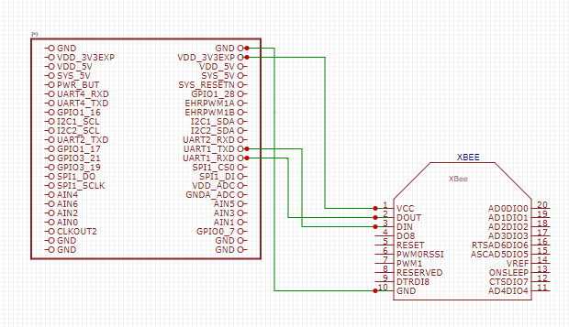
Interfacing of Xbee Module with BB-WI

Slide 17
NodeMCU ESP8266
The NodeMCU ESP8266 development board comes with the ESP-12E module containing ESP8266 chip having Tensilica Xtensa 32-bit LX106 RISC microprocessor. This microprocessor supports RTOS and operates at 80MHz to 160 MHz adjustable clock frequency

Slide 18
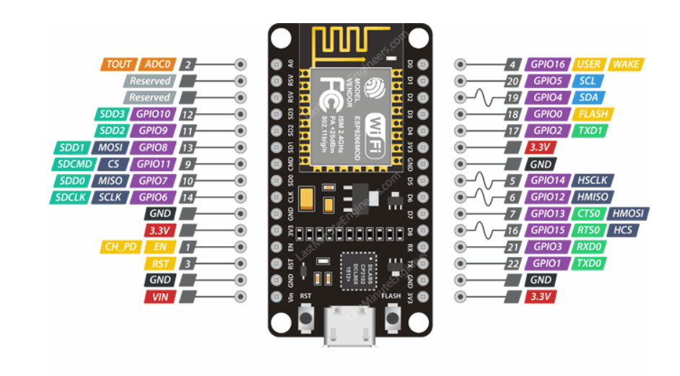
Pin diagram of NodeMCU ESP8266

Slide 19
Interfacing of NodeMCU ESP8266 with BB-WI
NodeMCU ESP8266 | Beaglebone Black Wireless
3.3V | P9_3(VDD_3V3)
GND | P9_1(DGND)
Tx | P9_26(UART1_RxD)
Rx | P9_24(UART1_TxD)

Slide 20
Buzzer
A buzzer or beeper is an audio signaling device, which may be mechanical ,electromechnical or piezoelectric. Typical uses of buzzers and beepers include alarm devices, timers and confirmation of user input such as a mouse click or keystroke.

Slide 21
Interfacing of Buzzer with Beaglebone Black Wireless
Red wire(+ve) of buzzer connected to 23rd pin(GPIO_49) of P9 header of BB-WI.
Black wire(Ground) of buzzer connected to 1st pin(DGND) of P9 header of BB-WI.

Slide 22
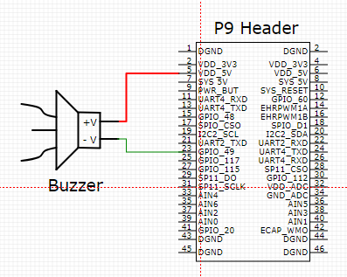
Interfacing of Buzzer with Beaglebone Black Wireless

Slide 23
MQ 2 Sensor
MQ2 gas sensor is an electronic sensor used for sensing the concentration of gases in the air such as LPG, propane, methane, hydrogen, alcohol ,smoke and carbon monoxide.

Slide 24
Interfacing of MQ 2 sensor with BB-WI
BB-WI(P9 Header) | MQ 2 Sensor
1(DGND) | GND
5(VDD 5V) | Vcc
33 (AIN4) | Vout

Slide 25
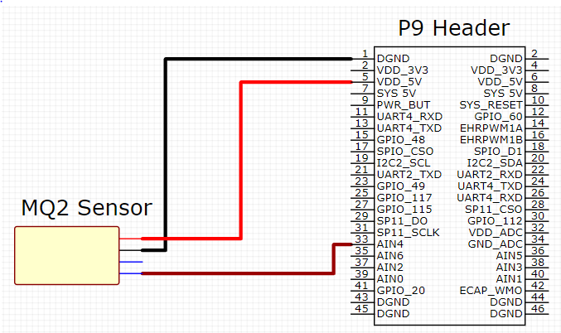
Interfacing of MQ 2 sensor with BB-WI

Slide 26
MQ 9 Sensor
A gas sensor is a device which detects the presence or concentration of gases in the atmosphere. Based on the concentration of the gas the sensor produces a corresponding potential difference by changing the resistance of the material inside the sensor, which can be measured as output voltage. Based on this voltage value the type and concentration of the gas can be estimated.

Slide 27
Interfacing of MQ 9 sensor with BB-WI
BB-WI(P9 Header) | MQ 9 Sensor
2 (DGND) | GND
6 (VDD 5V) | Vcc
36 (AIN5) | Vout

Slide 28
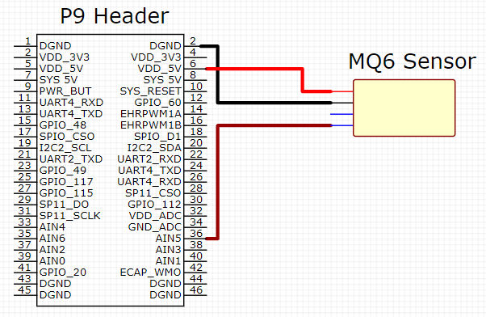
Interfacing of MQ 9 sensor with BB-WI

Slide 29
Temperature Sensor
LM35 is an analog sensor (Temperature Sensor) which measures the temperature and linear output given in voltage form. ADC is required to convert analog output of temperature sensor to digital output. Since BBB has an on chip ADC, we can directly interface these two.

Slide 30
Interfacing of Temperature sensor with BB-WI
Temperature Sensor | BB-WI (P9 Header)
GND | 1 (DGND)
Vcc | 5 (VDD 5V)
Vout | 38 (AIN3)

Slide 31
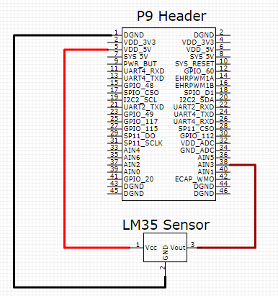
Interfacing of Temperature sensor with BB-WI

Slide 32
MCT2E Opto-coupler
MCT2E is a phototransistor Optocoupler, as the name “phototransistor” suggests it has a transistor which is controlled based on light (photon).this IC basically has an IR (infrared) LED and a photo-transistor inside it. When the IR led is powered the light from it falls on the transistor and it conducts.

Slide 33
Interfacing of MCT2E Optocoupler with BB-WI
Pin no 1 of MCT2E with gpio_67 pin 8 of P8 header of Beagle bone black wireless.
Pin no 2 of MCT2E with DGND pin 1/2 of P9 header of Beagle bone black wireless.
Pin no 4 of MCT2E with GND of Breadboard
Pin no 5 of MCT2E with positive (red wire) of DC fan.

Slide 34
LCD Display(20*4)
LCD stands for Liquid Crystal Display. It is basically a screen that is used as an electric display module which has various range of applications. Most commonly used module is 16*2 LCD display and it is used in various devices and circuits. But we are using 20*4 LCD Display for this project. These modules are preferred over seven segments and other multi segment LEDs. It is basically available in electronic visible display, video display and flat panel display

Slide 35
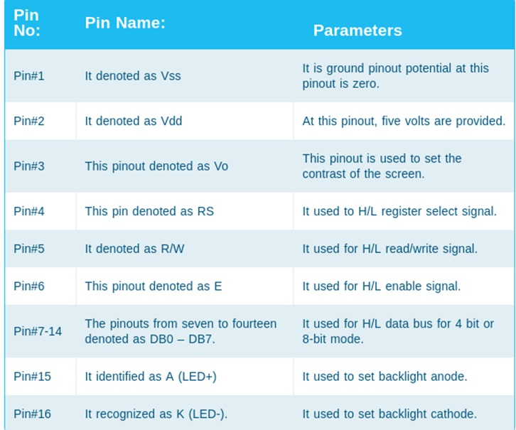
Pin Description of LCD Display

Slide 36
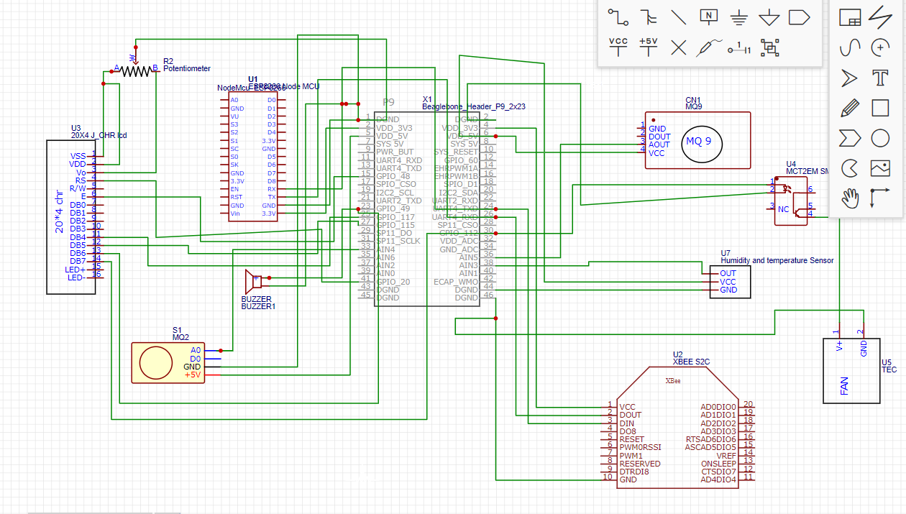
PCB Designing

Slide 37
References:
BB-WI
https://beagleboard.org/support/bone101
NodeMCU
https://lastminuteengineers.com/esp8266-nodemcu-arduino-tutorial/
Xbee Module
https://components101.com/wireless/xbee-s2c-module-pinout-datasheet
Buzzer
https://en.wikipedia.org/wiki/Buzzer

Slide 38
References:
Sensors:
https://components101.com/sensors/mq2-gas-sensor
https://wiki.seeedstudio.com/Grove-Gas_Sensor-MQ9/
https://www.fierceelectronics.com/sensors/what-a-temperature-sensor#:~:text=A%20temperature%20sensor%20is%20an,monitor%2C%20or%20signal%20temperature%20changes
Opto-coupler
https://components101.com/ics/mct2e-phototransistor-optocoupler-ic
PCB
https://en.wikipedia.org/wiki/Printed_circuit_board

Slide 39
References:
EasyEDA:
https://docs.easyeda.com/en/FAQ/Editor/index.html
https://www.youtube.com/watch?v=utBQqcuOt9U

